Slide 1

Political Theories-1
Hasan Muhammad Baniamin

Slide 2
Political Theory
It is anything about politics or relevant to politics.
It is the disciplined investigation of political problems- George Sabine
A network of concepts and generalization about political life-David Held.
It also involves application of the methods of science in order to develop descriptive and explanatory knowledge

Slide 3
Political theorist and their works
Plato’s Republic,
Aristotle’s Politics,
Hobbes’ Leviathan, or
Rawls’ A Theory of Justice

Slide 4
Types
Nature based
  Normative political theory offers explicit arguments and proposes answers to the significant “should” questions in the political world. Example: Plato, Aristotle, Confucius, Thomas Hobbes, John Locke, Karl Marx, and John Stuart Mill’s theory
  Empirical political theory, which relies upon observation and analysis of real-world data as it attempts to apply the methods of science in order to develop descriptive and explanatory knowledge claims about the political world. Example: Inglehart and Welzel

Slide 5
Types(Contd.)
Time based
  Classical: Plato, Aristotle
  Enlightenment-contractualist: Thomas Hobbes, John Locke
  Contemporary/Modern: John Rawls, David Easton

Slide 6
Do you know what is ‘SPA’?
  Socrates
  Plato
  Aristotle

Slide 7
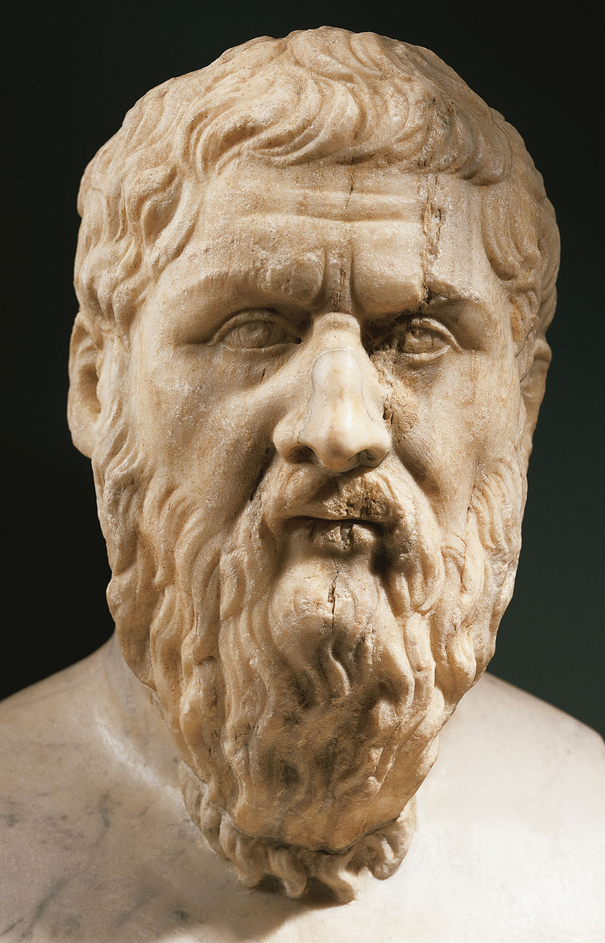
Plato
Greek philosopher.
His famous work is ‘The Republic’.
He seeks to rationalize, spiritualize, and universalize the ideal life for the polis (the Greek city-state).

Slide 8
Plato
Aristocracy is government by the best.
Timocracy is government by people of honor and ambition.
Oligarchy—government by the rich and lovers of money (what we could also call plutocracy)
Democracy- government by the many poor.
It emerges “after the poor have conquered their [oligarchic] opponents.” It is based on everyone’s having “an equal share of freedom and power.”
Democracy, however, is also unstable. It degenerates into tyranny, which emerges when democratic people, preoccupied with “liberty and equality,” lose a sense of law and order, a sense of discrimination, and turn to a “champion” to protect them against the rich.
Tyranny, the lawless rule of one individual, is the worst form of government and receives Plato’s harshest criticism.

Slide 9
Plato
He seeks to establish the polis on sound principles, suffuse it with excellence, and help it endure- a republic.
Justice, Plato argues, is the harmonious ordering of the functional classes in the polis: philosophers ruling, soldiers defending, and farmers and artisans providing the necessary food, clothing, and utensils for everyday life.
In this fashion, the wise would rule, the brave would defend, and those with basic appetites and talents would sustain the polis with their labor. Plato believes that the philosopher-kings should order the life of the polis in accordance with a vision of the good that their superior intellect allows them to perceive.

Slide 10
Plato
Criticism : Plato’s critics attack him as an enemy of the open society, hostile to democracy, a proponent of censorship, and an advocate of a rigid-class society.

Slide 11
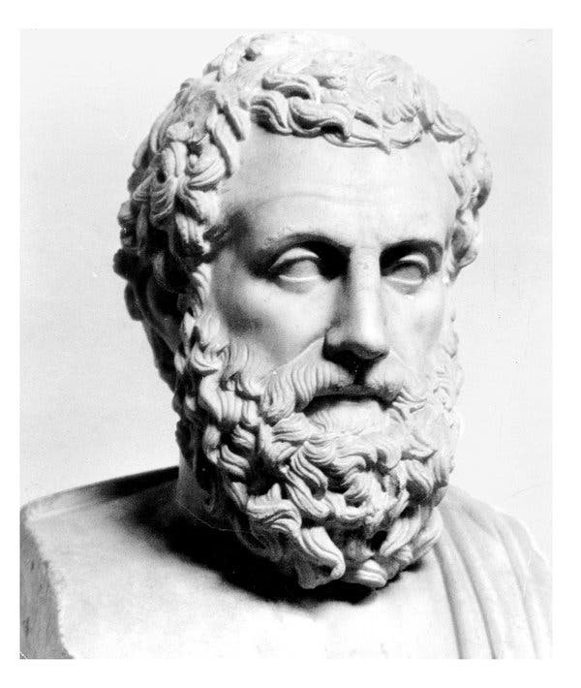
Aristotle
Aristotle criticizes key features of Plato’s Republic as unrealistic, especially his advocacy for the class of philosopher-kings.
Aristotle seeks to adjust Plato’s severely aristocratic principles to the actualities of life in Greek political communities.
Greek philosopher and taught by Plato
Founder of the Lyceum – school of philosophy.
The remains of the Lyceum were discovered in modern Athens in 1996

Slide 12
Aristotle
Aristotle’s answer is the polity, or constitutional government—a mixture of democracy and oligarchy.
Such a government would rest most securely on a well-educated, reasonably virtuous, sufficiently wealthy, moderate middle class.
The middle class is more likely to represent a “golden mean” between poverty and riches. It would not be envied by the poor or feared by the rich.
Members of this class would be interested in politics and good government but would not be overly ambitious. Moreover, the middle class would be able to maintain the rule of law and justice.

Slide 13
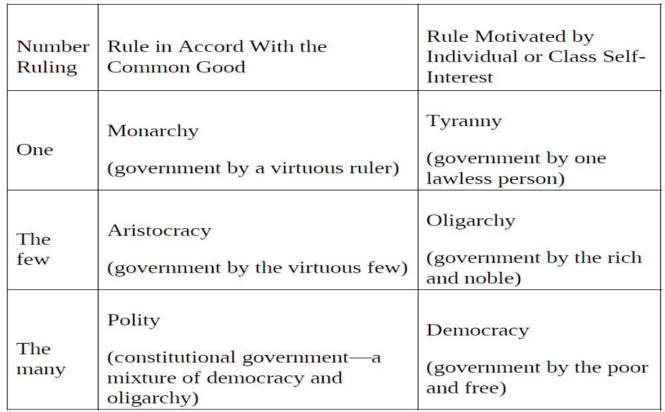
Aristotle’s Classification of Government

Slide 14
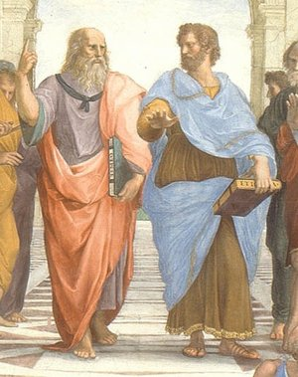
Plato and Aristotle
Aristotle- Realist
Plato- Idealist
Raphael’s School of Athens

Slide 15
Plato and Aristotle
Plato | Aristotle
Idealism | Realism
Republic | Politics
The ‘ideal state’ | A working government
Transcend human selfishness | Acknowledge human selfishness
Social unity | Balance

Slide 16
Suggested readings
Simon, D. W., Romance, J., & Riemer, N. (2018). The Challenge of Politics: An Introduction to Political Science. CQ press., pp 245-250

Slide 17
Q?

